Slide 1

Introduction
I recently completed a project that delved into the stock portfolio of an investor I admire.
The goal was simple: understand how well the portfolio was doing, figure out Thought process and align it better with long-term return expectations. I love numbers and finance, so this project was a lot of fun for me.

Slide 2
First, I gathered a bunch of data and cleaned it up, making sure it was all good and ready for analysis. Then, I used some cool math stuff to find out interesting things about the portfolio.
I looked at how each type of stock did, which ones were doing super well, and which ones maybe weren't doing so great.
I also checked out how much of the portfolio was in different types of businesses, like banks, tech companies, and others.
I wanted to see if having a mix of these was a good idea or if I should change it up. Some stocks were stars, doing way better than others,.

Slide 3

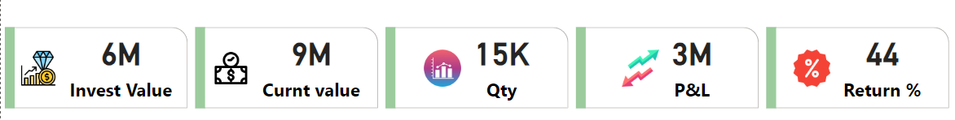
Investment Portfolio Overview

Slide 4
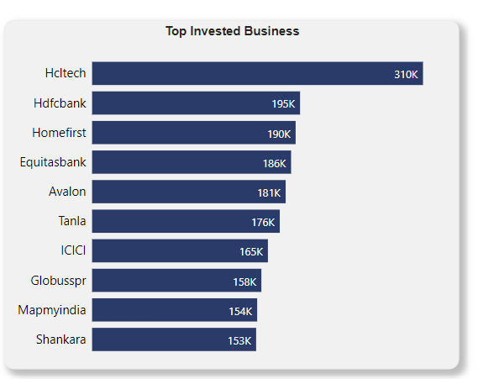
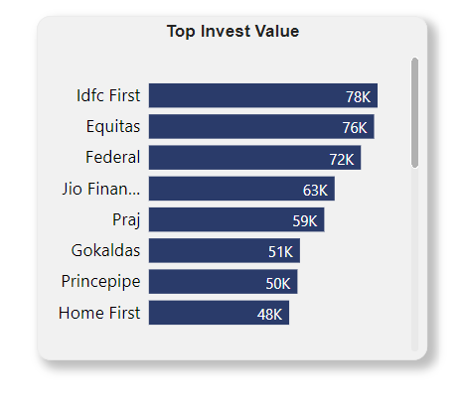
Top 10 Business Investment

Slide 5
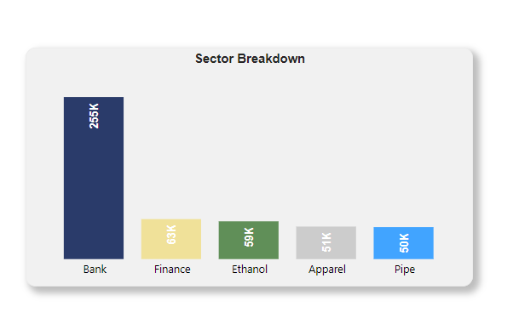
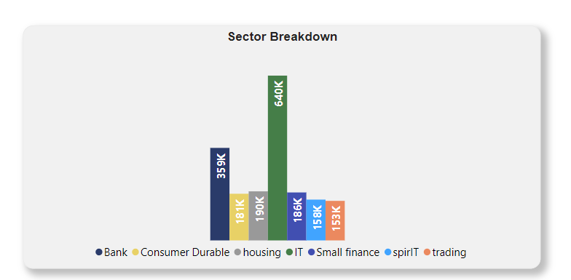
Sector Breakup

Slide 6
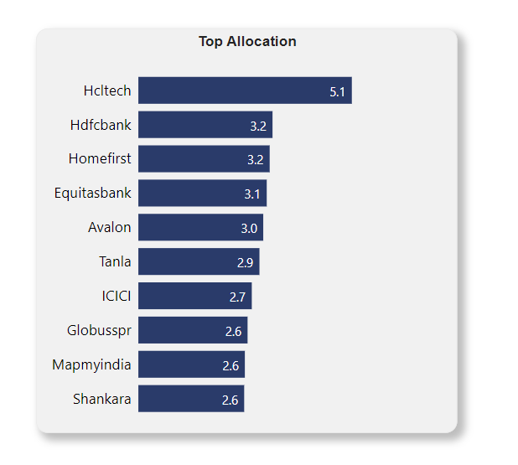
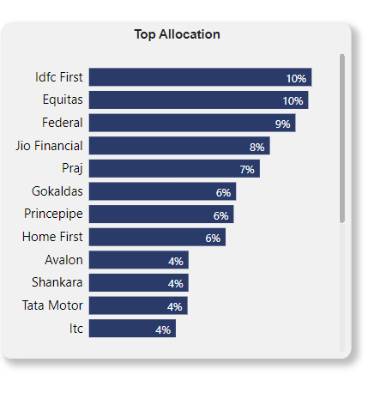
Top Capital Allocation

Slide 7
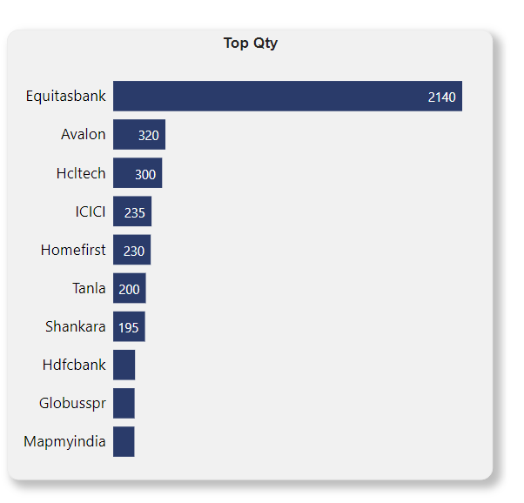
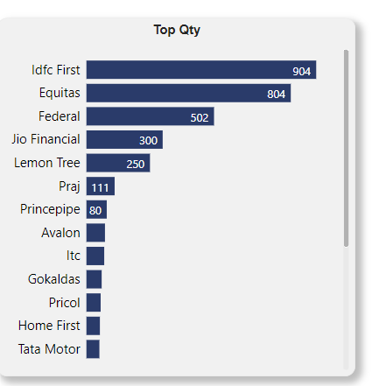
Top Business Qty

Slide 8
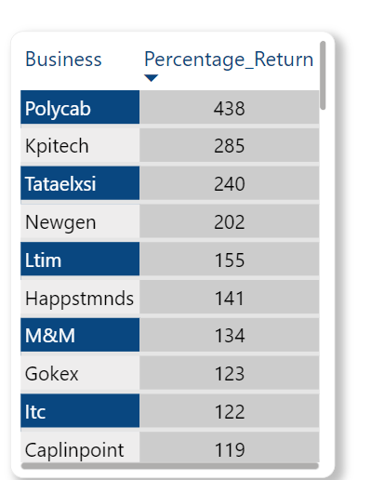
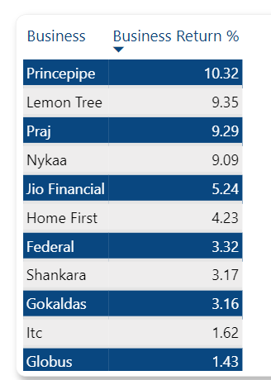
Top Business Percentage Return

Slide 9
Insight
Sir is quite bullish on financial stocks and has a strong belief in the financial sector.
The highest capital allocation in his portfolio is in large-cap businesses.
Sir has more than 6 multi bagger stocks in his portfolio.
His top investments include HCL Tech, HDFC Bank, Home First, and Poly-cab.
The stocks that have generated the highest return in his portfolio are KPIT, Tata elxsi , and Poly-cab.

Slide 10
Insight 2
The standout feature in every business or stock in Sir's portfolio is strong leadership.
Most of the stocks have been a part of Sir's portfolio for a long time.
3. The portfolio returns suggest that Sir has stuck with these stocks with high conviction and patience.

Slide 11
Actionable Insight
Patience for Wealth: Success in building wealth requires patience and persistence.
Discipline and Temperament: Hold onto investments with discipline and the right temperament.
Behavior Over Smartness: Wealth creation is more about good financial behavior than intelligence
Long Attention Span: Develop a long attention span for sustained success.
Emulate Warren Buffett: Follow Warren Buffett's patient and disciplined approach to investing.
Business-Like Investing: Treat investing like a business, focusing on understanding fundamentals.
Family Finance Basics: Success in family finance comes from consistently practicing good financial habits.
Realistic Expectations: Building wealth is a gradual process; set realistic expectations and be patient.

Slide 12
Conclusion: Now that I've done all this, I've got a clearer picture of the portfolio. I can make smarter decisions about my own investments. I learned a bunch from this project, like what works well and what doesn’t. Looking ahead, I might tweak a few things in my portfolio to make sure it's on track for the long run. It's cool how understanding the numbers can help you make better choices with your money.

Slide 13
Thank You

